Slide 1

RSA Encryption with Diffie HELMAN Key Exchange using AES-256 algorithm
Karan MODI
VINCENT Loud
AVRO Mukherjee

Slide 2
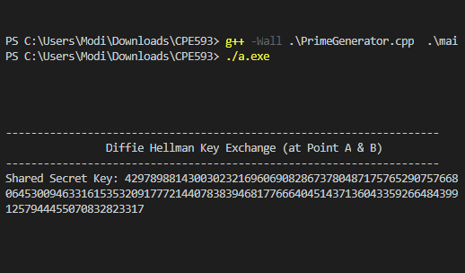
STEP 1: Generating Diffie Hellman Shared Key

Slide 3
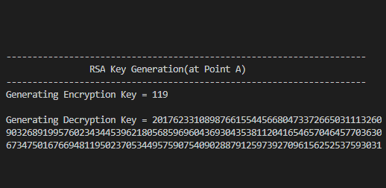
STEP 2: Generating RSA Encryption KEY and Decryption Key

Slide 4
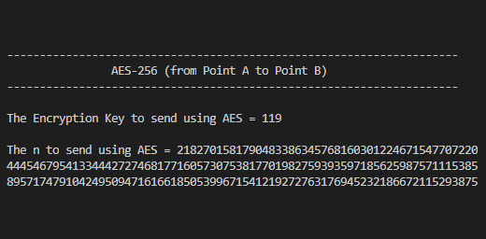
STEP 3 : SEND e and n from a to b
We would use AES to Encrypt the Encryption Key “e” and Prime Multiple “n = p* q” and transmit it from A to B

Slide 5
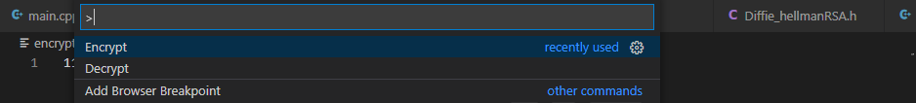
STEP 4 : encrypting and Sending enc key
Step a
Step b
Step c
Similarly, we would use AES to Encrypt n = p* q and transmit it from A to B and vice versa

Slide 6
STEP 5: decrypting Received enc key
Step a
Step b
Step c
Similarly, we would use AES to Decrypt n = p* q and transmit it from A to B and vice versa

Slide 7
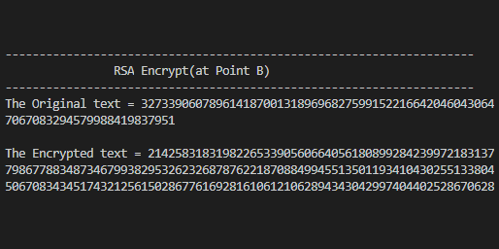
STEP 6 : Encrypting message using Enc key
We would use the Encryption Key “e” and Prime Multiple “n = p* q” received from A and encrypt the message from B

Slide 8
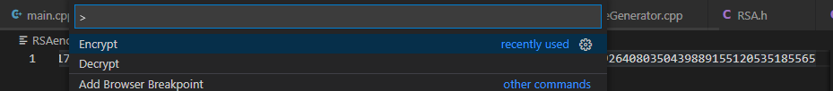
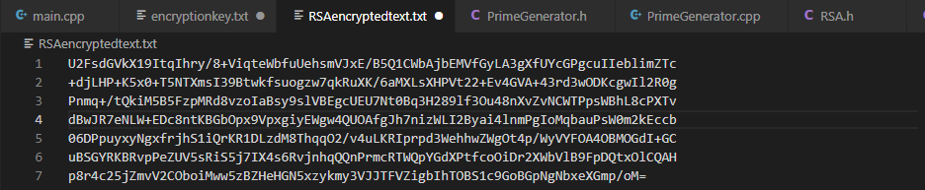
STEP 7 : encrypting and Sending Message
Step a
Step b
Step c
Like earlier, we would use AES to decrypt the encrypted Cipher Text at A

Slide 9
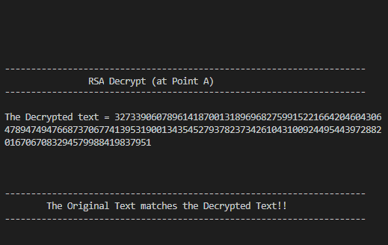
STEP 8: Decrypting message using Dec key
We use the Decryption Key “d” and “n”; and apply it to Cipher Text, to decrypt the RSA Cipher Text and decrypt the Cipher Text to receive the original message.

